Slide 1
Puppet Installation, Configuration and Use
Part 2

Slide 2

XSEDE
XSEDE is a single virtual system that scientists can use to interactively share computing resources, data and expertise. People around the world use these resources and services — things like supercomputers, collections of data and new tools — to improve our planet.
Please go to https://www.xsede.org/ and register
After you register, send me your XSEDE ID so I can add you to our project

Slide 3
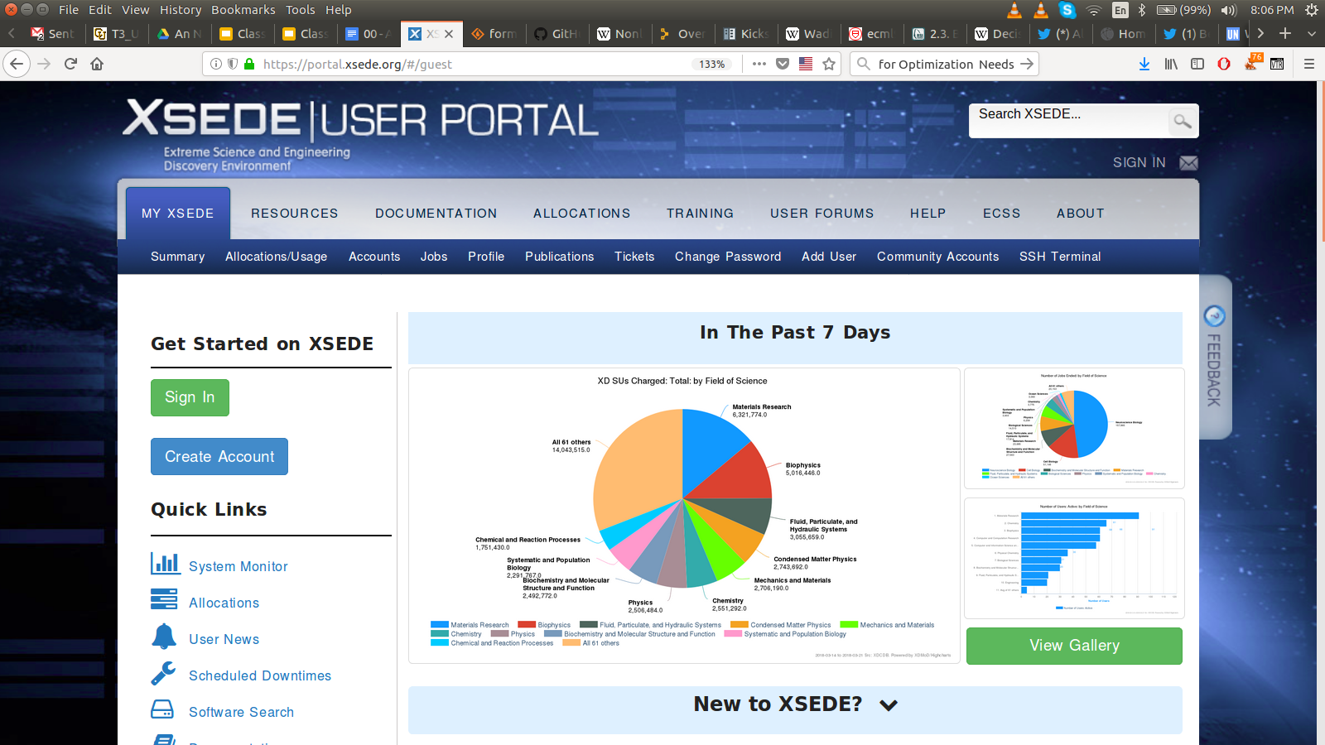

Slide 4
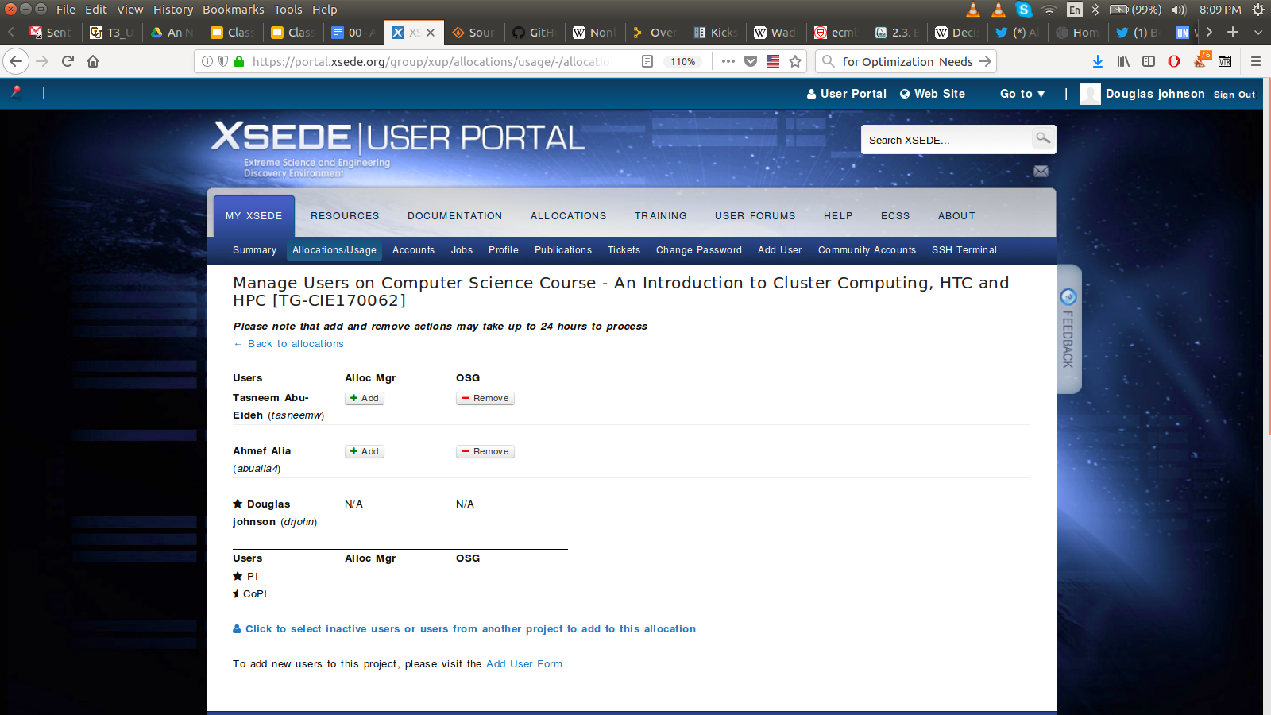

Slide 5
If I receive an ssh key error:
It can always be ignored
It means I have to reinstall the operating system on the client
It means I have to reinstall the operating system on the server
I have to reset the system ssh keys on the client
I have to reset the account ssh keys on the client

Slide 6
Review:
Fixing ssh key error -
Discussed symbolic links -
Using symbolic links to use different kickstart files
Started Puppet installation Make sure you are working from:
ssh-keygen -R hostname
ln -s ToFile FromFile
pbsgold-laptop> ln -s ToFile FromFile
pbsgold-laptop> ls -al FromFile
lrwxrwxrwx 1 drjohn drjohn 6 Mar 21 21:49 FromFile -> ToFile
htcXXX-minimal.ks
htcXXX-gui.ks
htcXXX-puppet-agent.ks
Class 6 - Puppet Installation and Configuration

Slide 7
To reinstall the operating system on the client
I change the kickstart file and reboot the client
I issue the koan commands on the server to reset Cobbler
I can clear the Master Boot Record (MBR) and reboot
I issue the koan commands on the Client to reset the Cobbler Server
I change the boot order in the BIOS

Slide 8
Review:
ReInstalling CentOS7: To reinstall the client operating system, use the client commands:
cobbler_server=htcServer
cobbler_client=htcClient
koan --server=$cobbler_server --replace-self --profile=$cobbler_client
koan --server=$cobbler_server --replace-self --system=$cobbler_client
IMPORTANT: Do not run these commands on the Cobbler Server
See: Class 4 - Cobbler Client Commands

Slide 9
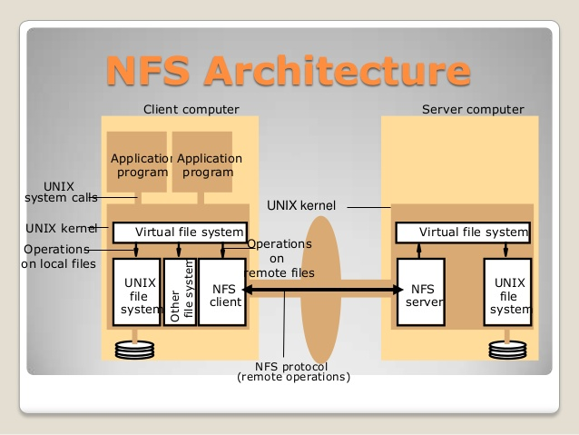
Introduction to NFS and autofs
Network File System (NFS) is a distributed file system protocol allowing a user on a client computer to access files over a computer network much like local storage is accessed. NFS is still widely supported and used on Linux machines today.
NFS Server - Exports file system
NFS Client - Mounts file system
Both systems see the same files and file system
See the document:
Class 7 - Introduction NFS and autofs
Please wait until the end of class or the next class before working on NFS and autofs

Slide 10
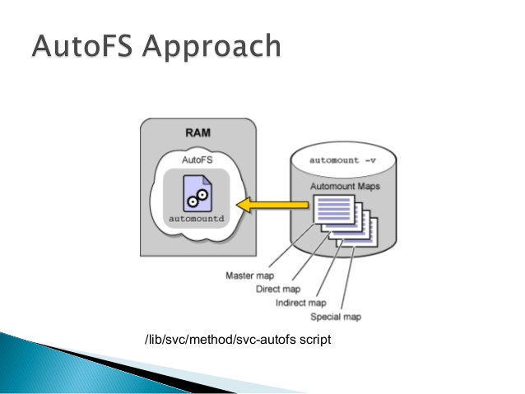
Auto-magically NFS mounting
When we have many NFS file systems on many different servers, we do not want to have them all mounted all the time. The software system autofs will control automatically mounting and unmounting file systems when the Client tries to access them.
autofs monitors access to directories and will automatically NFS mount disks. For example, if autofs is configure to monitor /nfs, then:
student> ls /nfs student> ls /nfs/htc180/AnNajah-Files file1 file2 file
The first ls did not find any files
The second ls caused the disk /nfs/htc180 to be mounted and now we find file1, file2 and file3

Slide 11
The NFS file system:
Is a distributed file system developed for Linux
Requires the client to export the file system to the server
Is a high performance file system for cluster computing
A computer is either an NFS server or an NFS client
A computer can be both an NFS server and an NFS client

Slide 12
New organizational document
00 - An Najah HTC Class Agenda
Will continuously update for each class
Please check before class - Refer to during the class
Class 7 Agenda: Puppet Installation and Configuration 2
March 22, 2018 Objective: Continue puppet installation
Class Slides: Class 7 - Puppet Installation, Configuration and Use 2 XSEDE Reminder Review Introduce NFS and autofs
Support documents for the in-class work: Please do not work through this document until Class 8 Class 7 - Introduction NFS and autofs
In-class documentation: Class 6 - Puppet Installation and Configuration
Make sure you are working
from this document

